Slide 1
Workplace
the material was prepared by a student of the group B18-504 Mahmudov Muhammad

Slide 2
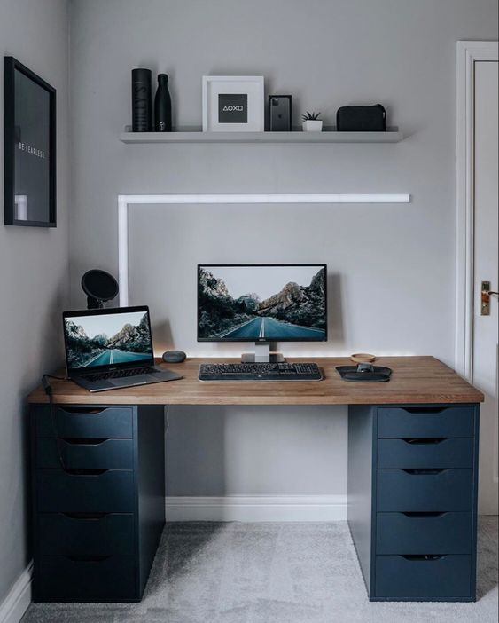
What should the workplace be like?

Slide 3
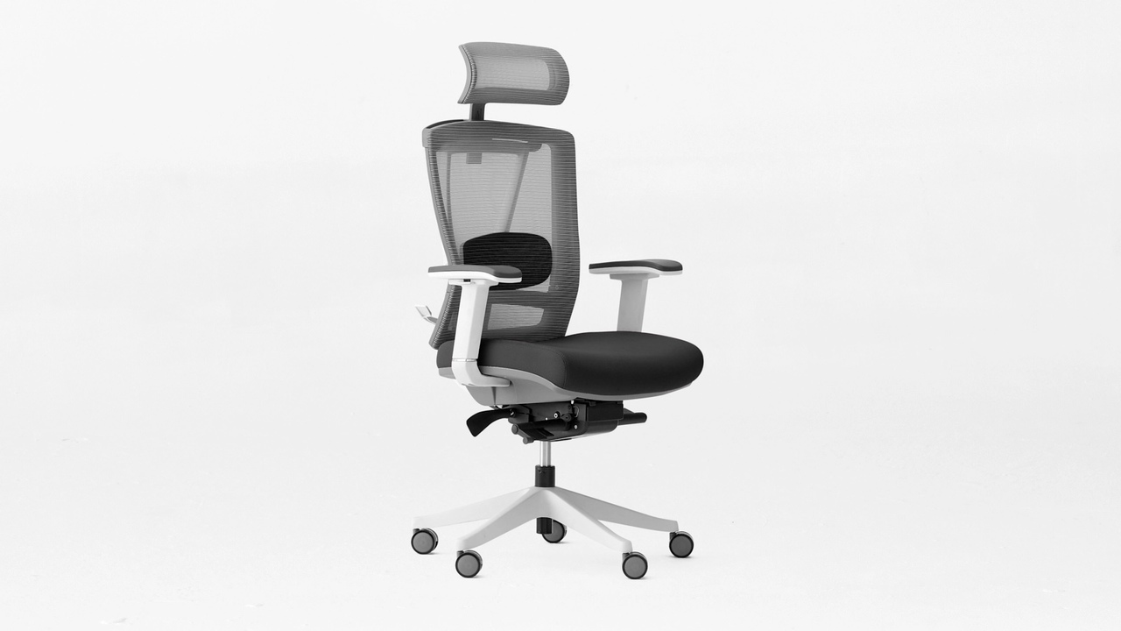
Choosing a chair

Slide 4
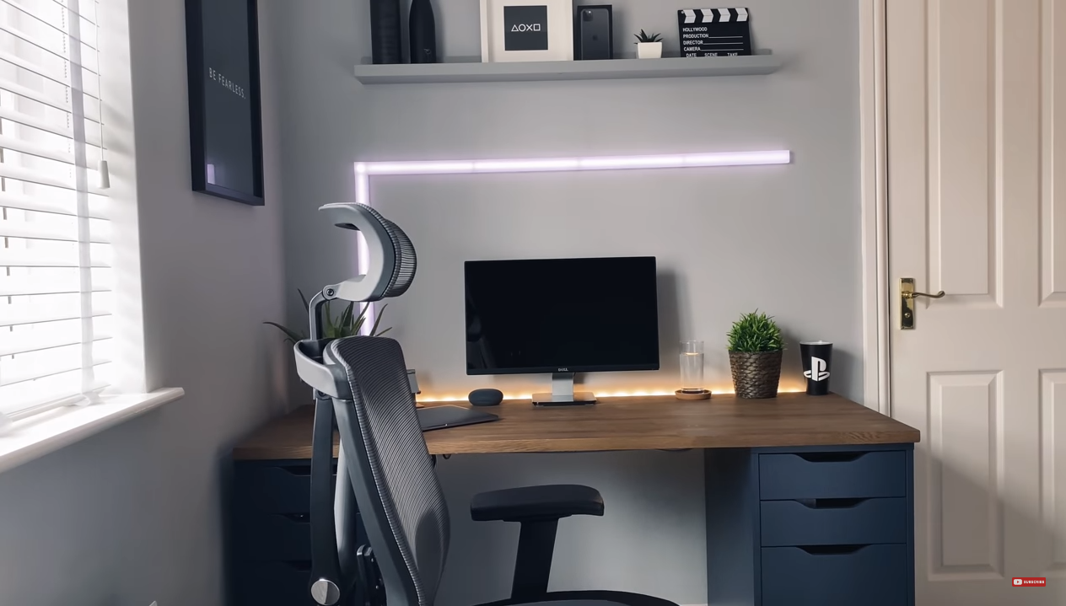
LEDs

Slide 5
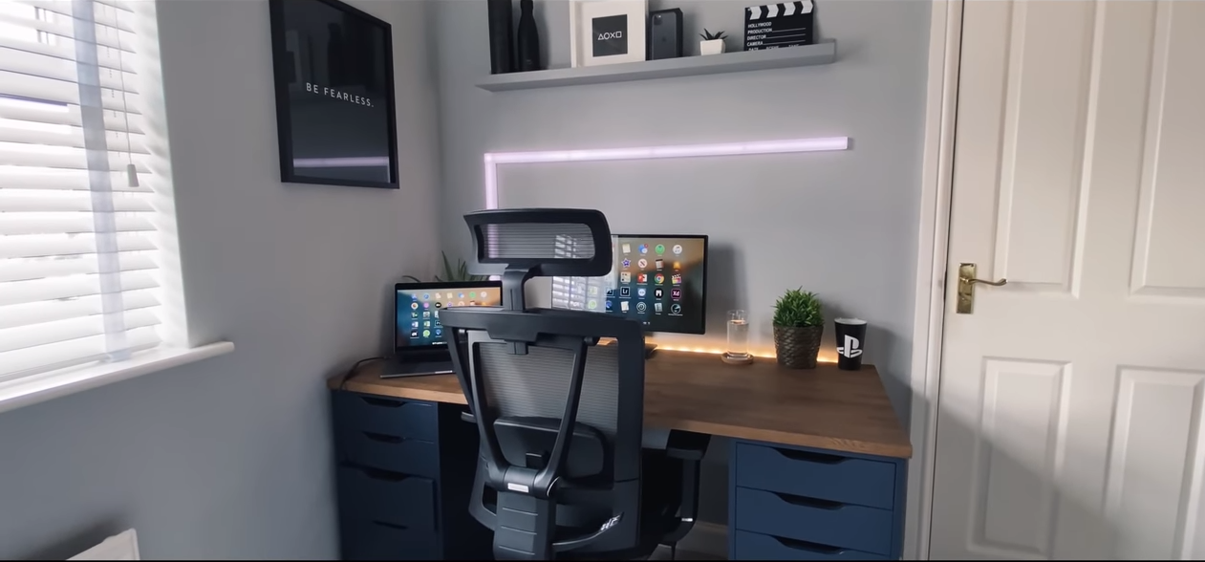

Slide 6


Slide 7
Thanks for your attention
All videos and photos were taken from the YouTube channel SpawnPoiint

